Slide 1



India’s EV Market: Sales, Growth, and Future Outlook Strategic Expansion: AtliQ Motors’ Comprehensive Market Analysis for India’s Electric Vehicle Sector
CodeBasics resume project challenge #12
Notes:
"Hello, I’m Rupsa Chaudhuri, presenting a comprehensive analysis of India's EV market. This presentation was made possible with the valuable content and resources from Codebasics team. Let's explore the strategic expansion opportunities for AtliQ Motors in the Indian EV market."

Slide 2

Agenda
Problem Statement
Project Overview
Primary Questions
Secondary Questions
Additional Analysis
Dashboard Summary
Notes:
"Here’s the agenda for today’s presentation. We will start with the problem statement, followed by a project overview, delve into the primary and secondary questions, summarize the dashboard findings, and conclude with additional insights and recommendations."

Slide 3


Problem Statement
AtliQ Motors, an American automotive giant known for its electric vehicles (EVs), has seen its market share rise to 25% in North America over the past five years. As part of their expansion into India, where their current market share is less than 2%, Bruce Haryali, the chief of AtliQ Motors India, has asked us to conduct a detailed market study of the EV/Hybrid sector in India.
In my role as Peter Pandey, the data analyst, I analyzed the data to answer the questions outlined in the provided document. I designed a clear and intuitive dashboard to present my findings and used additional research to support my recommendations. The goal was to create a compelling and concise presentation, focusing on good storytelling, for Bruce Haryali.
Notes:
“Here’s the problem statement . AtliQ Motors, with a significant market share in North America, is expanding into India where they currently hold less than 2% of the market. The goal is to analyze the Indian EV market to identify opportunities for growth and strategic expansion. In my role as Peter Pandey, the data analyst, I analyzed the data to answer the questions outlined in the provided document. I designed a clear and intuitive dashboard to present my findings and used additional research to support my recommendations. "

Slide 4

Project Overview
Objective: To analyze the EV market in India from 2022 to 2024, providing insights into sales performance, state penetration rates, and growth trends to support AtliQ Motors' expansion into the Indian market.
Focus: The analysis focuses on identifying top and bottom EV makers, evaluating state performance, analyzing quarterly sales trends, and projecting future growth rates to support AtliQ Motors' expansion strategy.
Datasets: The analysis uses `dim_date` for date-related information, `electric_vehicle_sales_by_makers` for sales data by maker, and `electric_vehicle_sales_by_state` for sales and total vehicle data by state.
Data Handling Techniques:
Missing Values: Checked for and handled missing values to ensure data completeness.
Data Types: Verified and adjusted data types, including converting date columns to datetime format for accurate analysis.
Duplicate Values: Addressed duplicate entries by standardizing naming conventions, such as merging 'Andaman & Nicobar' with 'Andaman & Nicobar Island' to ensure consistency.
Notes:
Here is the project overview: The objective of this project is to analyze EV sales, penetration rates, and growth trends from 2022 to 2024 to support AtliQ Motors' expansion into India. Comprehensive datasets, provided by the codebasics team, have been utilized. To ensure accurate insights, robust data handling techniques were employed: handling missing values to maintain data completeness, verifying and adjusting data types, particularly by converting date columns to datetime format, and addressing duplicate entries by standardizing naming conventions, such as merging 'Andaman & Nicobar' with 'Andaman & Nicobar Island'.

Slide 5

Primary Questions
Data-Driven Analysis of Sales, Penetration Rates, and Growth Trends
Notes:
This analysis is centered around 10 primary questions that are crucial for understanding the dynamics of the Indian EV market and formulating AtliQ Motors' expansion strategy."

Slide 6
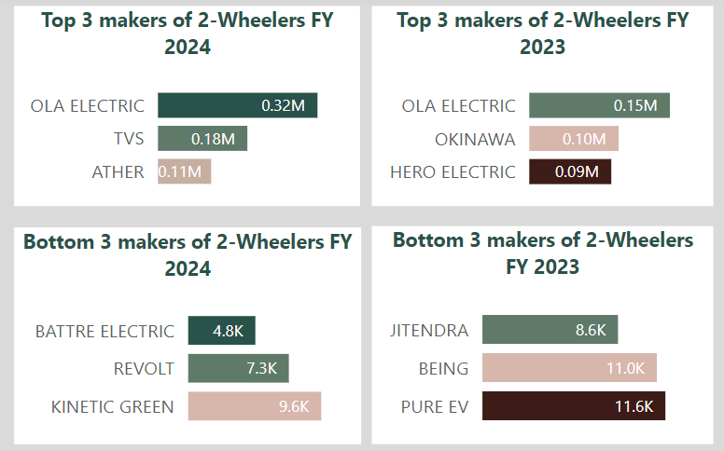
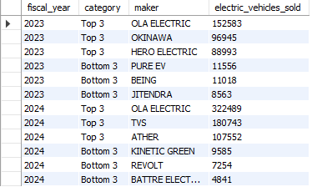
Q1. List the top 3 and bottom 3 makers for the fiscal years 2023 and 2024 in terms of the number of 2-wheelers sold.
Notes:
The first question addressed was identifying the top 3 and bottom 3 EV makers for the fiscal years 2023 and 2024 in terms of 2-wheeler sales. The data revealed that OLA ELECTRIC dominated both years, while smaller companies such as JITENDRA and BATTRE ELECTRIC struggled to gain market share. This insight is crucial for understanding the competitive landscape and potential threats in the market.

Slide 7
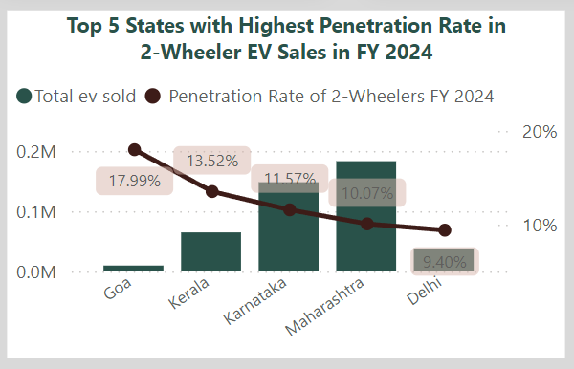
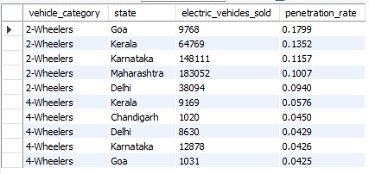
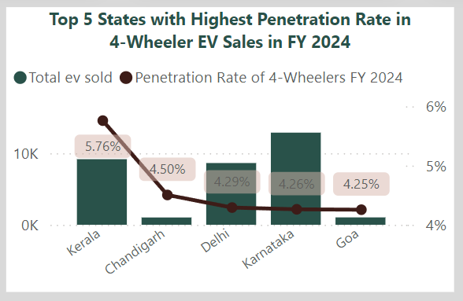
Q2. Identify the top 5 states with the highest penetration rate in 2-wheeler and 4-wheeler EV sales in FY 2024
Notes:
Next, the analysis focused on the top 5 states with the highest penetration rates for 2-wheeler and 4-wheeler EV sales in FY 2024. Goa and Kerala emerged as leaders, indicating strong consumer adoption of EVs in these states. This information is essential for targeting marketing efforts and sales strategies.

Slide 8
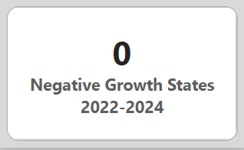
Q3. List the states with negative penetration (decline) in EV sales from 2022 to 2024?
Notes:
The analysis also examined whether any states showed negative penetration, indicating a decline in EV sales from 2022 to 2024. Interestingly, no states exhibited a decline, suggesting a consistently growing market across India. This reflects positively on the overall market potential for AtliQ Motors.

Slide 9
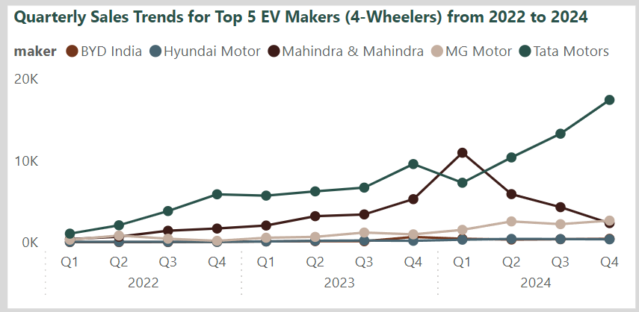
Q4. What are the quarterly trends based on sales volume for the top 5 EV makers (4-wheelers) from 2022 to 2024?
Notes:
Another key area of focus was understanding quarterly sales trends for the top 5 EV makers in the 4-wheeler category from 2022 to 2024. Tata Motors and Mahindra & Mahindra exhibited significant growth, particularly as 2024 approached. These trends highlight the increasing consumer confidence in 4-wheeler EVs and assist in forecasting future sales patterns.

Slide 10
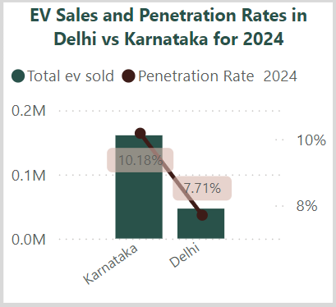
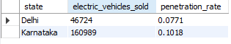
Q5. How do the EV sales and penetration rates in Delhi compare to Karnataka for 2024?
Notes:
Comparing EV sales and penetration rates in Delhi and Karnataka for FY 2024 provided insights into regional market dynamics. Karnataka outperformed Delhi with a higher penetration rate, indicating a stronger adoption rate in the state. This comparison is vital for regional strategy development.

Slide 11
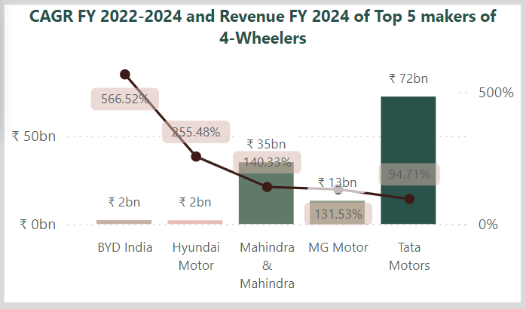
Q6. List down the compounded annual growth rate (CAGR) in 4-wheeler units for the top 5 makers from 2022 to 2024.
Notes:
The Compound Annual Growth Rate (CAGR) for the top 5 makers in the 4-wheeler category from 2022 to 2024 was also calculated. BYD India showed the highest CAGR, indicating rapid market expansion, while Tata Motors, a more established player, experienced steady growth. Understanding these growth rates helps identify emerging players and market leaders.

Slide 12
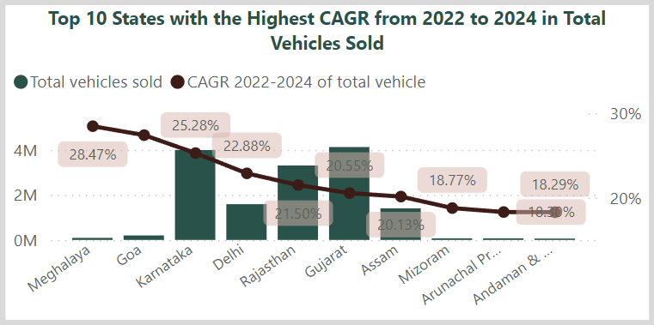
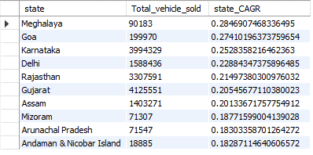
Q7. Top 10 States with the Highest CAGR from 2022 to 2024 in Total Vehicles Sold
Notes:
Identifying the top 10 states with the highest CAGR in total vehicle sales from 2022 to 2024 pinpointed regions with the fastest market expansion. Meghalaya, Goa, and Karnataka led in growth, reflecting areas with significant sales potential. This insight is crucial for market entry and expansion planning.

Slide 13
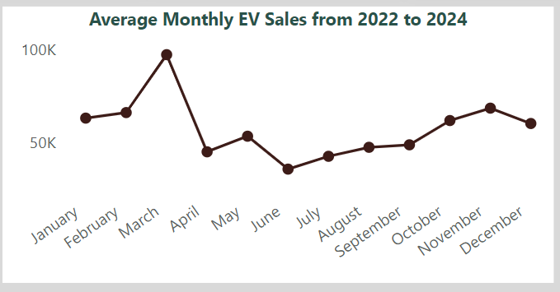
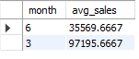
Q8. Peak and Low Season Months for EV Sales from 2022 to 2024
Notes:
Understanding the peak and low seasons for EV sales between 2022 and 2024 helps in inventory and marketing management. March emerged as the peak sales month, while June was the lowest, possibly due to the onset of the monsoon season. This seasonal trend is important for planning production and promotional activities.

Slide 14
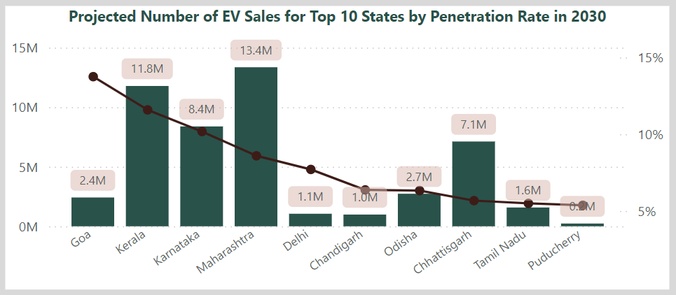
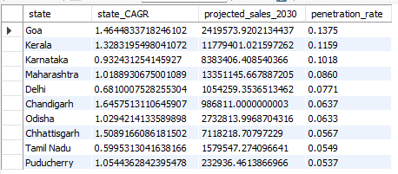
Q9. What is the projected number of EV sales (including 2-wheelers and 4- wheelers) for the top 10 states by penetration rate in 2030, based on the compounded annual growth rate (CAGR) from previous years?
Notes:
We projected the number of EV sales for the top 10 states by penetration rate in 2030 based on previous growth trends. Kerala and Maharashtra are expected to lead in future sales, which is critical information for long-term strategic planning."

Slide 15
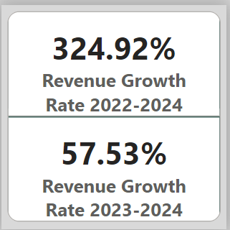
Q10. Estimate Revenue Growth Rate of EVs in India for 2022 vs 2024 and 2023 vs 2024.
Notes:
Lastly, the revenue growth rate of EVs in India from 2022 to 2024 was estimated. The analysis revealed a dramatic increase of 324.92% between 2022 and 2024, reflecting a booming market. However, the growth rate slowed between 2023 and 2024, suggesting market stabilization. This financial insight is vital for understanding profitability and market dynamics.

Slide 16
Secondary Questions
Exploring Market Dynamics, Customer Behavior, and Strategic Recommendations
Notes:
Moving on to the secondary questions, these delve deeper into customer behavior, government policies, and strategic recommendations, providing a more comprehensive understanding of the market."

Slide 17

Q1.What are the primary reasons for customers choosing 4-wheeler EVs in 2023 and 2024 (cost savings, environmental concerns, government incentives)?
1. Cost Savings:
- Rising fuel prices and lower operational costs make EVs financially advantageous. The total cost of ownership, including fuel, maintenance, and tax incentives, results in significant savings over traditional vehicles.
2. Environmental Concerns:
- Increased awareness of climate change and the need for reduced carbon footprints lead to a preference for EVs, which produce zero tailpipe emissions and contribute to reducing urban air pollution.
3. Government Incentives:
- Central and state governments in India have introduced various subsidies and incentives to promote EV adoption. These include reduced GST rates, exemptions from road taxes, and subsidies on the purchase price, which make EVs more affordable.
Notes:
The first question explores why customers chose 4-wheeler EVs in 2023 and 2024. The primary reasons identified include cost savings, environmental concerns, and government incentives. Higher fuel prices combined with lower operational costs make EVs more economical overall, considering factors such as maintenance, fuel, and tax incentives. Additionally, growing climate awareness and the push to reduce carbon footprints drive a preference for zero-emission EVs, which help to mitigate urban pollution. Government incentives also play a significant role; subsidies, tax exemptions, and lower GST rates offered by Indian governments make EVs more affordable, further encouraging their adoption.

Slide 18
Q2. How do government incentives and subsidies impact the adoption rates of 2-wheelers and 4-wheelers? Which states in India provided most subsidies?
Government incentives and subsidies have significantly impacted the adoption of electric vehicles (EVs) in India by addressing cost barriers and supporting infrastructure development. The main effects include:
- Reduced Purchase Costs: Subsidies decrease the initial cost of EVs, making them more affordable, especially for middle-class consumers. For instance, the FAME II scheme offers incentives based on battery capacity, which helps EVs compete more effectively with traditional vehicles.
- Increased Adoption Rates: States such as Delhi, Maharashtra, and Karnataka, which offer substantial subsidies and additional benefits like tax exemptions and rebates, have experienced higher EV adoption rates. Delhi's policy, for example, provides up to ₹30,000 for two-wheelers and ₹1.5 lakh for four-wheelers, leading to a noticeable increase in EV sales.
- Infrastructure Support: Incentive programs often include investments in EV charging infrastructure, which alleviates range anxiety and further encourages EV adoption.
Overall, these government initiatives play a crucial role in accelerating EV adoption by making vehicles more affordable and supporting necessary infrastructure, particularly in states with aggressive subsidy programs.
Notes:
Next, the impact of government incentives and subsidies on the adoption rates of 2-wheelers and 4-wheelers was examined. The analysis revealed several key effects. First, reduced purchase costs are a significant factor, as subsidies, such as those provided under the FAME II scheme, lower the upfront cost of EVs, making them more accessible, particularly for the middle class. Additionally, higher adoption rates have been observed in states like Delhi, Maharashtra, and Karnataka, which offer generous subsidies and tax benefits, resulting in significant increases in EV sales. Furthermore, infrastructure support plays a crucial role, as incentives also fund the development of EV charging infrastructure, which helps alleviate range anxiety and encourages adoption. Overall, these initiatives contribute to making EVs more affordable and accessible, thereby accelerating their adoption, especially in states with robust subsidy programs.

Slide 19
Q3. How does the availability of charging stations infrastructure correlate with the EV sales and penetration rates in the top 5 states?
The availability of charging infrastructure is strongly correlated with EV sales and penetration rates:
Goa: With a high penetration rate in 2-wheelers, Goa has a dense network of charging stations, particularly in urban areas. The state government has also promoted home-charging solutions.
Kerala: The state’s comprehensive EV policy has facilitated the development of a robust charging network, contributing to high sales figures for both 2-wheelers and 4-wheelers.
Karnataka: Home to major cities like Bengaluru, Karnataka boasts an extensive charging network, which supports its high penetration rate and sales volumes.
Maharashtra: The state has prioritized charging infrastructure in its EV policy, leading to significant growth in EV sales.
Delhi: The capital has aggressively expanded its charging infrastructure, which has directly impacted its high EV penetration rates.
Conclusion: States with well-developed charging infrastructure have seen higher EV adoption rates, as the availability of charging stations reduces range anxiety and makes EV ownership more convenient.
Notes:
The third question analyzed the correlation between the availability of charging infrastructure and EV sales in the top 5 states. In Goa, high 2-wheeler penetration is attributed to a dense urban charging network and home-charging initiatives. Kerala’s strong EV policy has led to the development of robust charging infrastructure, which has boosted sales of both 2- and 4-wheelers. In Karnataka, major cities like Bengaluru support high EV sales with an extensive charging network. Maharashtra has seen significant growth in EV sales due to its prioritized charging infrastructure. Delhi’s aggressive expansion of charging stations has resulted in high EV penetration. The conclusion drawn is that states with well-developed charging infrastructure experience higher EV adoption rates, as the availability of charging stations reduces range anxiety and makes EV ownership more convenient.

Slide 20


Q4. Who should be the brand ambassador if AtliQ Motors launches their EV/Hybrid vehicles in India and why?
Virat Kohli: Appeals strongly to younger audiences and sports enthusiasts, representing dynamism and a modern lifestyle. His popularity can drive significant attention and engagement for AtliQ Motors, aligning well with the innovative and eco-friendly image of EVs.
Ayushmann Khurrana: is known for his roles in films that tackle social issues and promote progressive values, aligning with AtliQ Motors' focus on sustainability and innovation. He has a broad appeal across different demographics, including urban and semi-urban consumers, which aligns well with AtliQ Motors' target market. Ayushmann’s significant following on social media can enhance brand visibility and engagement, particularly among younger, tech-savvy audiences.
Conclusion: Ultimately, Ayushmann Khurrana might be the slightly better fit if AtliQ Motors aims to emphasize its commitment to social and environmental values, while Virat Kohli would be ideal for a more general appeal, emphasizing performance and broad market reach.
Notes:
The fourth question focused on selecting the ideal brand ambassador for AtliQ Motors' EV launch in India, with two candidates considered: Virat Kohli and Ayushmann Khurrana. Virat Kohli, who appeals to younger audiences and sports enthusiasts, symbolizes dynamism and a modern lifestyle. His popularity aligns well with AtliQ Motors' innovative and eco-friendly EV image, potentially driving strong engagement. On the other hand, Ayushmann Khurrana, known for addressing social issues in his films, aligns with AtliQ Motors' focus on sustainability and innovation. His broad appeal, particularly among urban and semi-urban consumers, enhances brand visibility and engagement, especially among tech-savvy youth. The conclusion is that Ayushmann Khurrana is ideal for emphasizing social and environmental values, while Virat Kohli offers broader market appeal, focusing on performance.

Slide 21
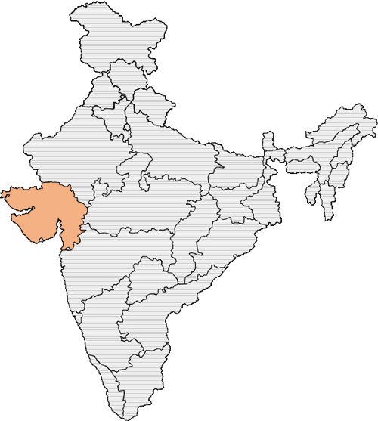
Q5. Which state of India is ideal to start the manufacturing unit? (Based on subsidies provided, ease of doing business, stability in governance etc.)
1. Maharashtra
- Subsidies and Incentives: Capital subsidies, interest subvention, exemptions from stamp duty and electricity duty.
- Ease of Doing Business: High ranking with streamlined processes.
- Infrastructure: Robust industrial corridors, ports, and supply chains.
- Governance and Stability: Stable governance with a focus on industrial growth.
2. Gujarat
- Subsidies and Incentives: Capital subsidies, concessional land rates, and electricity duty exemptions.
- Ease of Doing Business: Business-friendly environment with quick approvals.
- Infrastructure: Strong industrial infrastructure with a thriving automotive sector.
- Governance and Stability: Stable governance with proactive industrial policies.
3. Tamil Nadu
- Subsidies and Incentives: Capital subsidies, tax exemptions, and power tariff subsidies.
- Ease of Doing Business: High ranking with investor-friendly policies.
- Infrastructure: Established automotive base, skilled labor, and good connectivity.
- Governance and Stability: Consistent governance supporting industrial development.
Recommended State: Gujarat
Gujarat emerges as the ideal choice for AtliQ Motors due to its proactive policies, strong automotive ecosystem, and government support, making it a favorable destination for setting up an EV manufacturing unit.
Notes:
We then identified the ideal state for setting up AtliQ Motors' manufacturing unit in India. Maharashtra offers attractive capital subsidies, interest subvention, and exemptions from stamp and electricity duties. With a high ease of doing business ranking, streamlined processes, and robust industrial infrastructure, including corridors, ports, and supply chains, the state is well-positioned for industrial growth. Its stable governance further supports this environment. Gujarat stands out with its capital subsidies, concessional land rates, and duty exemptions, combined with a business-friendly environment that provides quick approvals. The state’s strong automotive sector and stable governance with proactive industrial policies make it a top choice. Tamil Nadu also provides capital subsidies, tax exemptions, and power tariff subsidies, backed by investor-friendly policies and high ease of doing business rankings. The state has an established automotive base, skilled labor, good connectivity, and consistent governance that supports industrial development.
Recommendation: Gujarat emerges as the ideal choice for AtliQ Motors due to its proactive policies, strong automotive ecosystem, and government support, making it a favorable destination for setting up an EV manufacturing unit.

Slide 22
Q6. Your top 3 recommendations for AtliQ Motors.
Expand in High-Growth States:
Karnataka, Kerala, and Goa: These states show the highest EV penetration rates and significant sales growth. AtliQ Motors should prioritize expanding its manufacturing units and distribution networks in these regions to tap into the growing demand.
Leverage Government Incentives: States like Gujarat and Tamil Nadu offer attractive subsidies, including capital investments, tax exemptions, and reduced land rates. Establishing production facilities in these states will reduce costs and enhance profitability, making it easier for AtliQ Motors to scale operations.
Strengthen Partnerships:
Collaborate with Leading EV Makers: Partnering with top performers like OLA ELECTRIC, TVS, Tata Motors, and Mahindra & Mahindra can help AtliQ Motors enhance its product offerings and access a larger customer base. These collaborations could also lead to shared resources in areas like supply chain management and marketing.
Invest in R&D: To maintain a competitive edge, AtliQ Motors should focus on innovation, particularly in battery technology, vehicle efficiency, and cost reduction. Joint R&D initiatives with established EV makers can accelerate the development of cutting-edge technologies, making AtliQ Motors a leader in the EV market.
Focus on Long-Term Growth:
Target High-Sales Regions by 2030: With states like Kerala and Maharashtra projected to have the highest EV sales by 2030, AtliQ Motors should prioritize these regions for future market expansion. This includes investing in charging infrastructure, localized marketing campaigns, and establishing strong dealer networks.
Capitalize on the Booming Market: The EV market in India has seen tremendous growth, with a 324.92% increase in revenue from 2022 to 2024. However, the growth rate is expected to stabilize, so AtliQ Motors should focus on sustainable strategies, such as improving customer retention, diversifying product lines, and exploring new business models like EV financing, leasing, or subscription services to maintain momentum.
Notes:
Finally, we presented three key recommendations for AtliQ Motors: AtliQ Motors should focus on expanding in high-growth states like Karnataka, Kerala, and Goa, where EV penetration rates and sales growth are highest. Prioritizing manufacturing and distribution in these regions will allow the company to tap into rising demand. Additionally, leveraging government incentives in states like Gujarat and Tamil Nadu, which offer subsidies on capital investments, tax exemptions, and reduced land rates, can help reduce costs and boost profitability. To strengthen market presence, AtliQ Motors should form strategic partnerships with leading EV makers like OLA ELECTRIC, TVS, Tata Motors, and Mahindra & Mahindra. These collaborations can enhance product offerings, improve supply chain management, and broaden customer reach.
Investing in R&D, particularly in battery technology, vehicle efficiency, and cost reduction, will help AtliQ Motors maintain a competitive edge. Joint R&D efforts with established players can fast-track innovation and position the company as a market leader. For long-term growth, AtliQ Motors should target high-sales regions like Kerala and Maharashtra, projected to lead EV sales by 2030, by investing in charging infrastructure, localized marketing, and robust dealer networks. With the Indian EV market growing 324.92% from 2022 to 2024, but expected to stabilize, AtliQ Motors must focus on sustainable strategies like enhancing customer retention, diversifying product lines, and exploring new business models such as EV financing, leasing, or subscriptions to maintain momentum.

Slide 23
Dashboard Summary
1. Market Overview
Total EV Sales: India’s EV market reached 1 million units sold in 2024, reflecting a substantial market growth of 276.03% from 2022 to 2024. The CAGR for this period stands at 93.91%.
Revenue Performance: In 2024, the market generated ₹209.63 billion in revenue. The revenue growth rate from 2022 to 2024 was 324.92%, with a growth rate of 57.53% between 2023 and 2024.
Future Projections: By 2030, EV sales in India are projected to reach 54 million units, indicating strong long-term market potential.
2. Segment Analysis
2-Wheelers vs. 4-Wheelers:
2-Wheelers: Dominated the market in 2024 with a 91.48% share and a penetration rate of 4.40%. OLA Electric was the top performer, with a significant CAGR of 373.22%.
4-Wheelers: Despite having a smaller market share, the 4-wheeler segment showed a higher revenue growth rate of 367.79% compared to 2-wheelers (269.28%). Tata Motors led the 4-wheeler market with the highest revenue, though new players like BYD India showed the highest CAGR of 566.52%.
Notes:
The dashboard summary highlights that India’s EV market saw significant growth in 2024, with total sales reaching 1 million units—a 276.03% increase from 2022 and a CAGR of 93.91%. Revenue hit ₹209.63 billion, growing 324.92% from 2022 to 2024 and 57.53% from 2023 to 2024. Projections indicate EV sales will reach 54 million units by 2030, highlighting robust long-term potential.
In segment analysis, 2-wheelers dominated the market in 2024, holding a 91.48% share with a penetration rate of 4.40%. OLA Electric led this segment with a notable CAGR of 373.22%. The 4-wheeler segment, though smaller, experienced a higher revenue growth rate of 367.79%, with Tata Motors leading in revenue. New entrants like BYD India showed the highest CAGR of 566.52%, indicating strong performance in the 4-wheeler market.

Slide 24
Dashboard Summary
3. State-Level Performance
Top Markets: Maharashtra and Karnataka are the leading markets, with Maharashtra generating the highest revenue in 2024 and Karnataka demonstrating strong sales growth and penetration rates.
Emerging Markets: Goa showed the highest penetration rate (13.75% projected by 2030) but with lower sales volumes, while states like Meghalaya are also showing rapid growth rates.
4. Quarterly and Seasonal Sales Trends
Top Makers' Quarterly Trends: Tata Motors showed consistent growth across quarters, while Mahindra & Mahindra peaked in early 2024 but faced a subsequent decline.
Seasonal Insights: The highest average monthly sales occurred in March (97,196 units), while the lowest were in June (35,570 units), suggesting seasonal demand fluctuations.
5. Competitive Landscape
Top Performers: OLA Electric and Tata Motors are the top performers in the 2-wheeler and 4-wheeler segments, respectively. However, newer entrants like BYD India are rapidly gaining market share due to their high growth rates.
Conclusion: The dashboard insights underscore the rapid expansion and high revenue potential of India's EV market, particularly in the 4-wheeler segment. Focusing on high-growth states like Maharashtra and Karnataka and leveraging seasonal trends can provide AtliQ Motors with strategic advantages as it plans its market expansion in India.
Notes:
Maharashtra and Karnataka lead the Indian EV market, with Maharashtra generating the highest revenue in 2024 and Karnataka showing strong sales growth and penetration. Goa, while having the highest projected penetration rate of 13.75% by 2030, has lower sales volumes. Meghalaya is also emerging with rapid growth. Quarterly trends reveal Tata Motors' consistent growth, while Mahindra & Mahindra peaked early in 2024 but later declined. Seasonal sales show peaks in March (97,196 units) and troughs in June (35,570 units), indicating demand fluctuations.
OLA Electric and Tata Motors are top performers in the 2-wheeler and 4-wheeler segments, respectively, with BYD India gaining rapidly due to high growth rates. Overall, India’s EV market is expanding quickly with significant revenue potential, especially in the 4-wheeler segment. AtliQ Motors should focus on high-growth states like Maharashtra and Karnataka and consider seasonal trends to strategically plan its market expansion.

Slide 25

Additional Analysis
Notes:
Additional analysis reaffirms the competitive landscape, emphasizing the need for product innovation, strategic partnerships, and expansion into underserved markets to stay ahead in the rapidly growing EV sector.

Slide 26
Competitor Analysis
AtliQ Motors faces significant competition in the Indian EV market, with key players like OLA Electric, Hero Electric, Ather Energy, TVS Motor Company, and Bajaj Auto leading various segments.
OLA Electric excels in two-wheelers and vertical integration but faces reliability issues.
Hero Electric benefits from brand recognition and affordability, though it has a limited product range.
Ather Energy offers premium, innovative products but is challenged by high pricing.
TVS Motor Company leverages its legacy but struggles with the transition from ICE to EVs.
Bajaj Auto capitalizes on iconic brands and a strong network but has a limited EV lineup.
Opportunities for AtliQ Motors include product innovation, targeting underserved segments, strategic partnerships, expanding into Tier 2 and Tier 3 cities, and emphasizing sustainability. However, threats like price wars, technological disruption, and regulatory changes must be navigated carefully.
Notes:
AtliQ Motors faces strong competition in the Indian EV market from key players such as OLA Electric, Hero Electric, Ather Energy, TVS Motor Company, and Bajaj Auto. OLA Electric leads in two-wheelers and vertical integration but struggles with reliability issues. Hero Electric benefits from brand recognition and affordability but has a limited product range. Ather Energy offers premium, innovative products but faces challenges due to high pricing. TVS Motor Company leverages its legacy but is struggling with the transition from ICE to EVs. Bajaj Auto capitalizes on its iconic brands and strong network but has a limited EV lineup.
For AtliQ Motors, opportunities include product innovation, targeting underserved segments, forming strategic partnerships, expanding into Tier 2 and Tier 3 cities, and focusing on sustainability. However, it must navigate threats such as price wars, technological disruption, and regulatory changes.

Slide 27
Competitor Pricing Analysis
1. Competitive Pricing Strategy: Position AtliQ Motors' pricing in line with competitors like OLA and Ather, with a tiered structure to cater to different segments, from budget-conscious buyers to premium customers.
2. Feature-Rich Value Proposition: Emphasize advanced features such as longer range and smart connectivity at competitive prices to differentiate AtliQ Motors in a crowded market.
3. Focus on Affordability: Introduce entry-level models priced under ₹1,00,000 to compete with Hero Electric, leveraging government subsidies to make EVs more accessible.
4. Promotions and Financing: Offer attractive financing options and promotional deals to boost sales, making EV ownership more accessible to price-sensitive consumers.
Notes:
AtliQ Motors should adopt a competitive pricing strategy, aligning with rivals like OLA and Ather while offering a tiered structure to serve both budget-conscious and premium customers. The company should emphasize advanced features such as longer range and smart connectivity to stand out in the market. Introducing entry-level models priced under ₹1,00,000 can help compete with Hero Electric, leveraging government subsidies to enhance affordability. Additionally, offering attractive financing options and promotional deals can boost sales and make EV ownership more accessible to price-sensitive consumers.

Slide 28
Expansion Strategy
1. Diversify Product Portfolio: Expand into electric three-wheelers, four-wheelers, and specialized vehicles like delivery vans and buses.
2. Expand Geographically: Focus on Tier 2 and Tier 3 cities in India and explore international markets in Southeast Asia and Africa.
3. Forge Strategic Partnerships: Collaborate with charging infrastructure providers, battery manufacturers, and R&D partners to enhance product offerings and innovation.
4. Strengthen Brand and Support: Enhance regional marketing, build a robust digital presence, adopt sustainable practices, and expand the service network to boost customer satisfaction and loyalty.
Notes:
AtliQ Motors should diversify its product portfolio by expanding into electric three-wheelers, four-wheelers, and specialized vehicles like delivery vans and buses. Geographic expansion should target Tier 2 and Tier 3 cities in India and explore international markets in Southeast Asia and Africa. Strategic partnerships with charging infrastructure providers, battery manufacturers, and R&D partners can enhance product offerings and drive innovation. Strengthening the brand through regional marketing, a robust digital presence, sustainable practices, and an expanded service network will boost customer satisfaction and loyalty.

Slide 29
Expansion Challenges
Supply Chain and Infrastructure Constraints:
Challenges with battery supply, component shortages, and inadequate charging infrastructure could lead to production delays and hinder EV adoption, particularly in less developed regions.
Regulatory and Market Competition:
Navigating inconsistent policies across states and international markets, along with intense competition from established players, requires strategic adaptation and significant investment.
Consumer Adoption and Awareness:
Overcoming range anxiety, low consumer awareness, and misconceptions about EVs, especially in smaller cities, will necessitate extensive educational campaigns and marketing efforts.
Financial and Technological Challenges:
High capital expenditure, the need for operational scalability, and keeping pace with rapid technological advancements are critical to maintaining competitiveness and ensuring long-term success.
Notes:
AtliQ Motors may face several constraints, including supply chain issues like battery shortages, component deficits, and inadequate charging infrastructure, which could delay production and hinder EV adoption, especially in less developed regions. Navigating regulatory inconsistencies and intense competition from established players may require strategic adaptation and significant investment. Overcoming consumer adoption challenges, such as range anxiety and low awareness, may necessitate extensive educational campaigns and marketing efforts. Additionally, managing high capital expenditure, achieving operational scalability, and keeping up with rapid technological advancements could be crucial for maintaining competitiveness and ensuring long-term success.

Slide 30

Thank you!
Notes:
Thank you and I want to extend my gratitude to Codebasics team for organising such premium resume project challenges and for providing the invaluable resources that made this presentation possible.

